Slide 1


Verification of Cryptocurrency Mining Using Ethereum
DONG-HER SHIH 1 , TING-WEI WU1 , TZU-HSIN HSU1 , PO-YUAN SHIH2 , AND DAVID C. YEN3

Slide 2
Concepts in Ethereum blockchain
Smart Contracts: Smart contracts are simply programs stored on a blockchain that run when predetermined conditions are met. They typically are used to automate the execution of an agreement so that all participants can be immediately certain of the outcome, without any intermediary’s involvement or time loss
dApps (decentralized apps): Software programs that run on a blockchain or peer-to-peer (P2P) network of computers instead of on a single computer. DApps are thus outside the purview and control of a single authority.

Slide 3
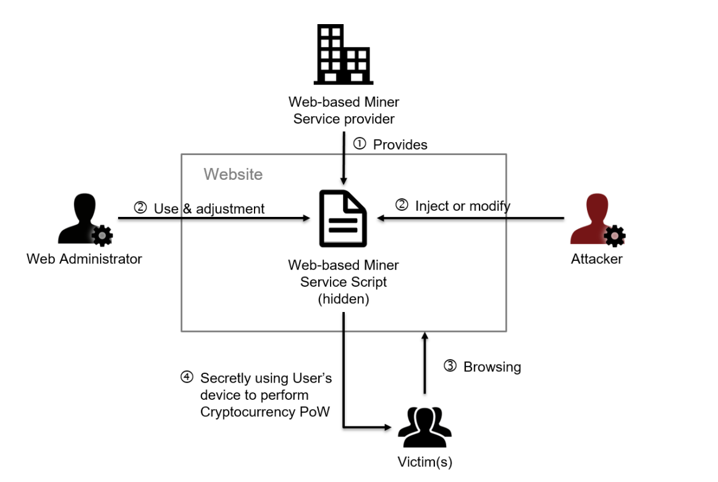
Crypto Jacking

Slide 4
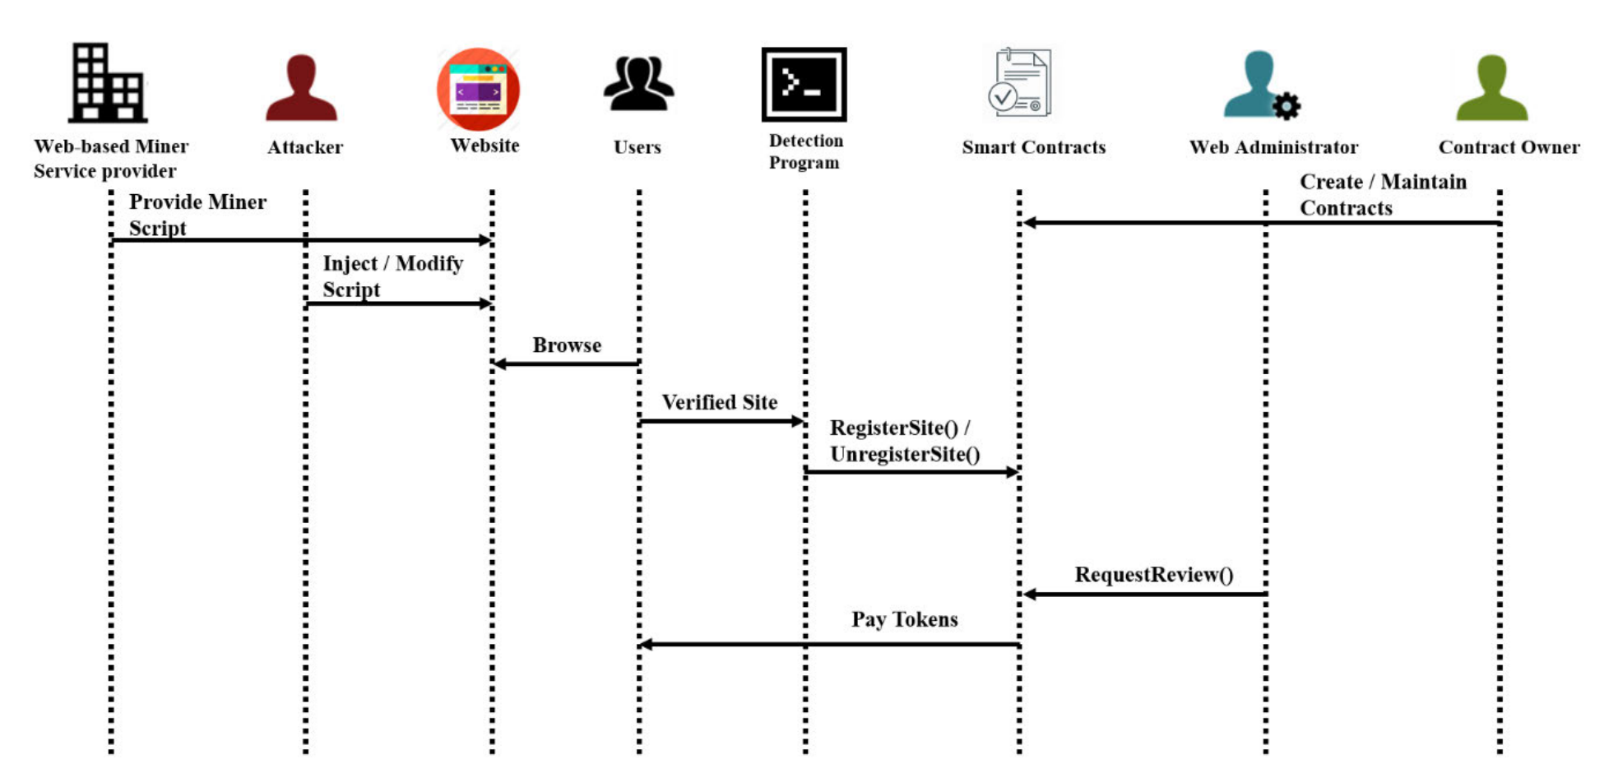
Basic flow of proposed verification

Slide 5
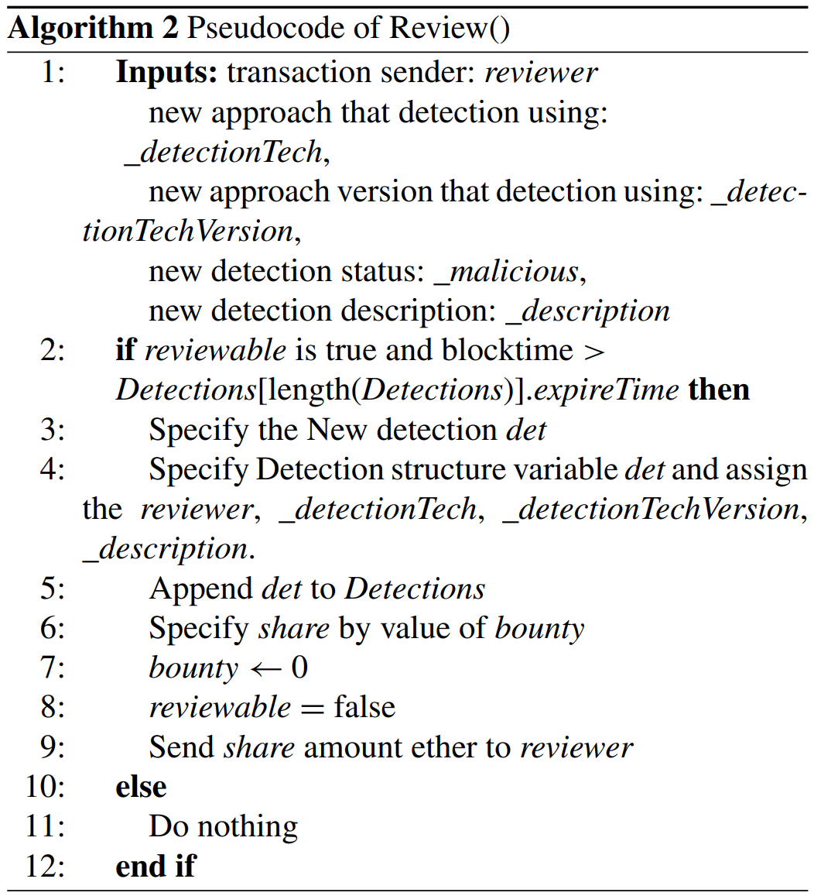
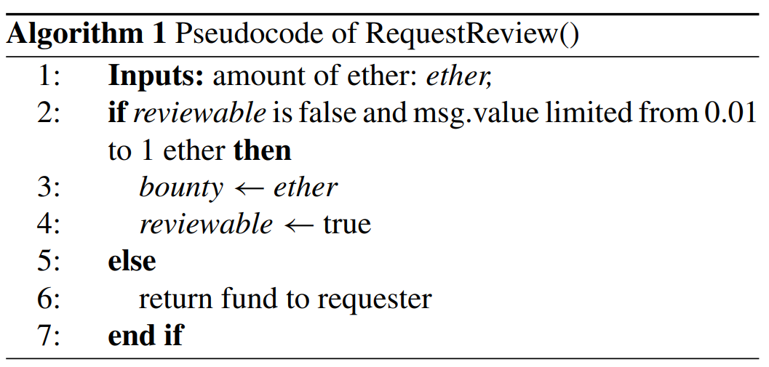
Example Pseudocodes from the paper

Slide 6
Paper Feedback
The Approach is very Naïve.
The writer said at the end of the paper and I quote “the smart contract of the research department did not undergo extensive stress testing. When too much data is accessed by the contract, the result is unknow” and continued by saying “However, the large-scale testing of smart contracts has not yet been achieved in the context of this study”.
The paper didn’t provide, explain and Name any detection algorithm instead it only referred to a reference paper.
The work of this paper was built on thoughts not scientific experiments with proofs.

